Slide 1
An Introduction to SQL
October 2019

Slide 2
What is SQL?
SQL is Structured Query Language, which is a computer language for storing, manipulating and retrieving data stored in relational database.
Why SQL?
It’s efficient.
Allows users to access data in relational database management systems.
Allows users to describe the data.
Allows users to define the data in database and manipulate that data.
Allows users to create and delete databases and tables.

Slide 3
Database structures
A database can be made up of many different tables
Database
Table 1
Table 2
Table 3
Record 1
Record 1
Record 1
Record 2
Record 2
Record 2
Record 3
Record 3
Record 3

Slide 4
Test Database
Tables within test database:
Customers
Categories
Employees
Order Details
Orders
Products
Shippers
Suppliers

Slide 5
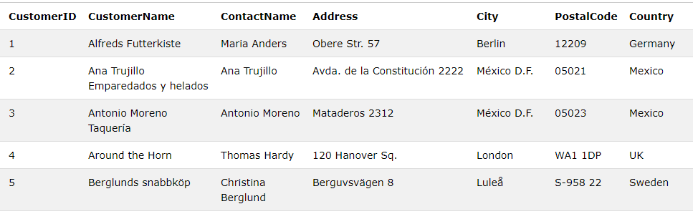
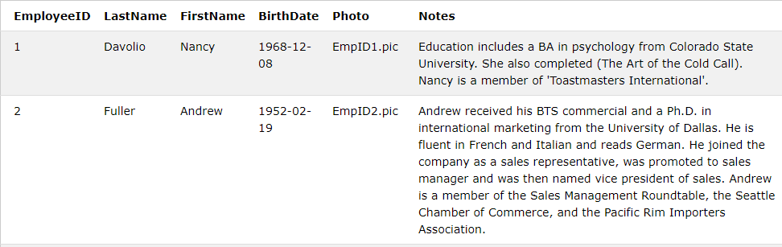
Test Database
Tables within test database:
Customers
Categories
Employees
Order Details
Orders
Products
Shippers
Suppliers

Slide 6
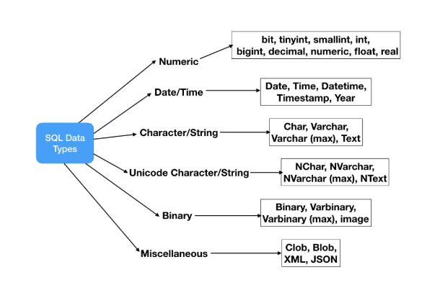
Data Types in SQL
Each column in a record has some data type attached to it.
It’s important to understand the structure of the dataset in order to know how to access the data.
Notes:
Image source https://www.journaldev.com/16774/sql-data-types

Slide 7
SQL Statements
Important to note is that SQL language and its statements are not case sensitive. The “SELECT” command will be read in the same way as the “select” command.
Many database systems require that each SQL statement is separated by a semicolon ( ; ). For this tutorial we will be following that convention.
The most important and frequently used statements:
SELECT
UPDATE
INSERT INTO
DELETE

Slide 8
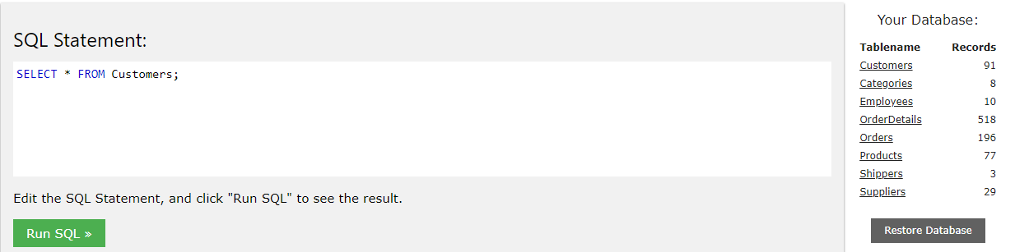
Access This Database
https://www.w3schools.com/sql/trysql.asp?filename=trysql_select_all

Slide 9
The Basic SELECT Statement
The structure of a SELECT statement can be broken down into:
SELECT column1, column2, ... FROM table_name;
SELECT * FROM Customers;
The statement reads “Select all records from the customers table”
The “*” statement is used as a shorthand to achieve this.

Slide 10
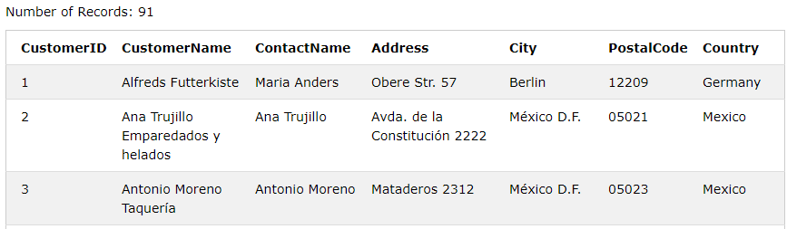
The Basic SELECT Statement
The structure of a SELECT statement can be broken down into:
SELECT column1, column2, ... FROM table_name;
SELECT * FROM Customers;

Slide 11
The Basic SELECT Statement with Conditions
The structure of a SELECT statement can be broken down into:
SELECT column1, column2, ... FROM table_name WHERE condition;
SELECT * FROM Employees WHERE FirstName= “Nancy”;
The statement reads “Select all columns from the employees table where the employee first name is Nancy”

Slide 12
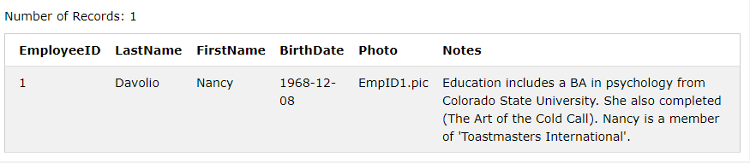
The Basic SELECT Statement with Conditions
The structure of a SELECT statement can be broken down into:
SELECT column1, column2, ... FROM table_name WHERE condition;
SELECT * FROM Employees WHERE FirstName= “Nancy”;

Slide 13
AND, OR, NOT Statements
Multiple conditions can be attached to the where clause with typical logic tests:
SELECT column1, column2, ... FROM table_name WHERE condition;
SELECT column1, column2, ... FROM table_name WHERE condition1 AND condition2 AND condition3 ...;
SELECT column1, column2, ... FROM table_name WHERE condition1 OR condition2 OR condition3 ...;
SELECT column1, column2, ... FROM table_name WHERE NOT condition;

Slide 14
The Basic SELECT Statement with Ordering
The structure of a SELECT statement with ordering can be broken down into:
SELECT column1, column2, ... FROM table_name ORDER BY column1, column2, ... ASC|DESC;
SELECT * FROM Customers ORDER BY Country DESC;
The statement reads “Select all columns from the customer table, order records by descending order of country (reverse-alphabetically)”

Slide 15
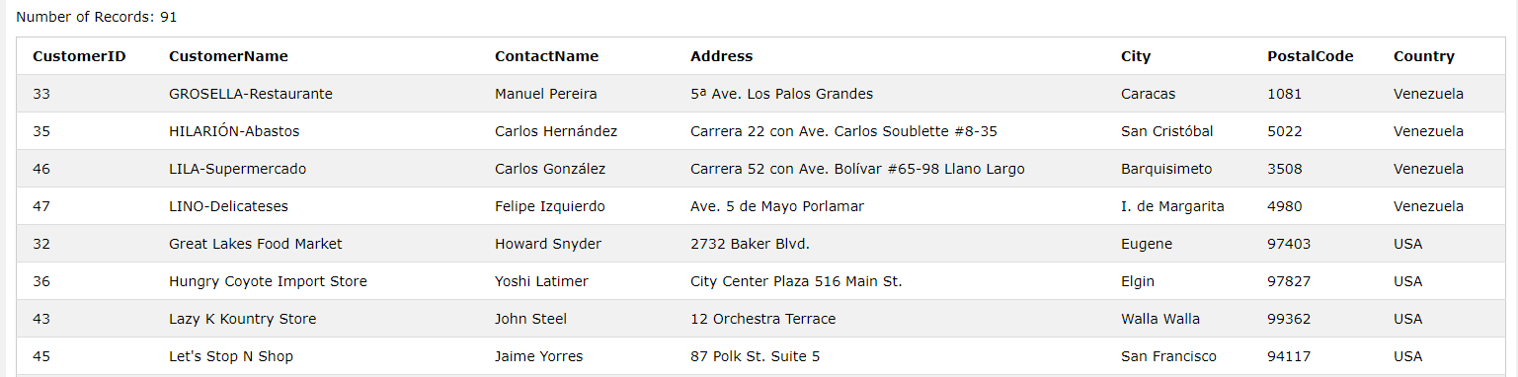
The Basic SELECT Statement with Ordering
The structure of a SELECT statement can be broken down into:
SELECT column1, column2, ... FROM table_name ORDER BY column1, column2, ... ASC|DESC;
SELECT * FROM Customers ORDER BY Country DESC;

Slide 16
Checkpoint 1 Questions
Find all records from the order details tables.
Select all records from the order details table where productid 11 was purchased and fewer than ten of these items were purchased.
Without using any other functions discussed up until now, how many orders have been processed where employee number 5 was not involved?

Slide 17
Checkpoint Questions
Find all records from the order details tables.
Select all records from the order details table where productid 11 was purchased and fewer than ten of these items were purchased.
Without using any other functions discussed up until now, how many orders have been processed where employee number 5 was not involved?
Answers:
SELECT * FROM OrderDetails;
SELECT * FROM OrderDetails WHERE ProductID = 11 AND Quantity<10;
SELECT * FROM Order WHERE NOT EmployeeID=5;
(185 Orders)

Slide 18
The INSERT Statement
The structure of an INSERT statement can be broken down into:
INSERT INTO table_name (column1, column2, column3, ...) VALUES (value1, value2, value3, ...);
INSERT INTO table_name VALUES (value1, value2, value3, ...);
INSERT INTO Customers (CustomerName, ContactName, Address, City, PostalCode, Country) VALUES ('SA Government', 'Cyril Ramaphosa', '11 Parliament Street', 'Cape Town', '6665', 'South Africa');
Note that we do not insert a value for the CustomerID. Many unique record identifiers (known as Primary Keys) use auto incrementing numbers for new records. Therefore we don’t need to put this number in as it is done for us.

Slide 19
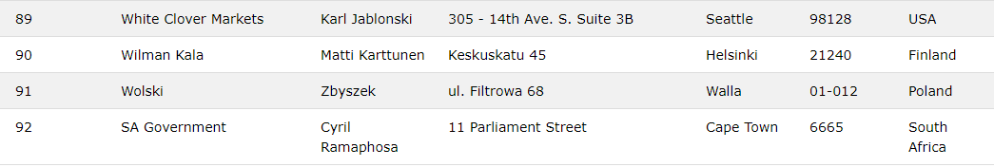
The INSERT Statement
The structure of an INSERT statement can be broken down into:
INSERT INTO table_name (column1, column2, column3, ...) VALUES (value1, value2, value3, ...);
INSERT INTO table_name VALUES (value1, value2, value3, ...);
INSERT INTO Customers (CustomerName, ContactName, Address, City, PostalCode, Country) VALUES ('SA Government', 'Cyril Ramaphosa', '11 Parliament Street', 'Cape Town', '6665', 'South Africa');

Slide 20
The UPDATE Statement
There are a number of scenarios in which a record/table may need to be updated. The structure of the update statement is given as follows:
UPDATE table_name SET column1 = value1, column2 = value2, ... WHERE condition;
To update a single record:
UPDATE Customers SET CustomerName = 'RSA Government’, ContactName= ’Syril Ramaphosa' WHERE CustomerID = 92;
To update all records in a table:
UPDATE Employees SET FirstName='Juan';

Slide 21
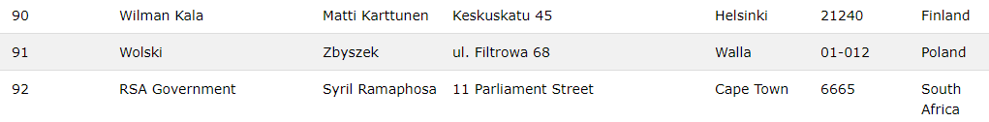
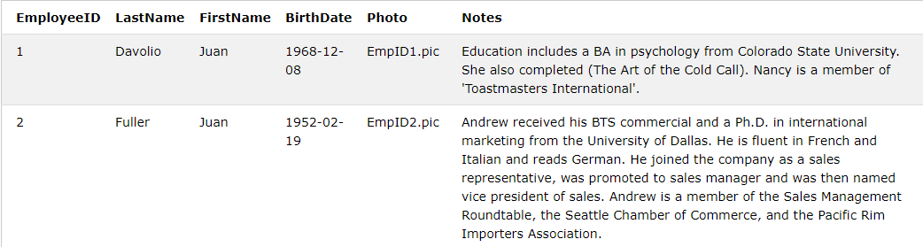
The UPDATE Statement
There are a number of scenarios in which a record/table may need to be updated. The structure of the update statement is given as follows:
To update a single record:
UPDATE Customers SET CustomerName = 'RSA Government’, ContactName= ’Syril Ramaphosa' WHERE CustomerID = 92;
To update all records in a table:
UPDATE Employees SET FirstName='Juan';

Slide 22
The DELETE Statement
While inserting and updating is a handy tool, being able to remove records is also of importance. The base delete statement is as follows:
DELETE FROM table_name WHERE condition;
To delete a single record:
DELETE FROM Customers WHERE CustomerName='RSA Government';
To delete all records in a table:
DELETE FROM Suppliers;

Slide 23
The DROP Statement
If you no longer need a table or database. The DROP statement can be used to remove the table/database. This command should be used with caution!
To delete a table:
DROP TABLE table_name;
DROP TABLE Orders;
To delete an entire database:
DROP DATABASE databasename;

Slide 24
Efficient Record Selection
Accessing a table with millions of records is a computationally expensive task. Instead of accessing all the records, we can access a certain percentage/number of records from the “top” of the search query. Depending on the specific type of SQL language you use (MySQL, Oracle, SQL Server etc.) this functionality may or may not be supported. When using MySQL, the statement is as follows:
SELECT column_name(s) FROM table_name WHERE condition LIMIT number;
SELECT * FROM Customers LIMIT 5;

Slide 25
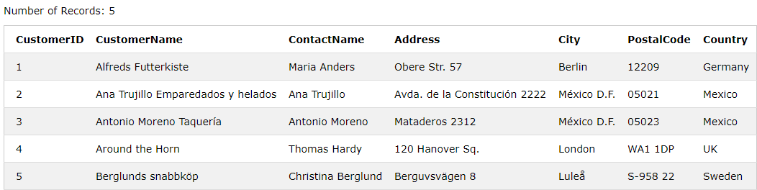
Efficient Record Selection
Accessing a table with millions of records is a computationally expensive task. Instead of accessing all the records, we can access a certain percentage/number of records from the “top” of the search query. Depending on the specific type of SQL language you use (MySQL, Oracle, SQL Server etc.) this functionality may or may not be supported. When using MySQL, the statement is as follows:
SELECT column_name(s) FROM table_name WHERE condition LIMIT number;
SELECT * FROM Customers LIMIT 5;

Slide 26
The MIN and MAX Function
The MIN() function returns the smallest value of the selected column whereas the MAX() function returns the largest value. The structure of a SELECT statement can be broken down into:
SELECT MIN(column_name) FROM table_name WHERE condition;
SELECT MAX(column_name) FROM table_name WHERE condition;
SELECT MIN(Price) AS SmallestPrice FROM Products;
The statement reads “Determine the minimum price of products in the products table”

Slide 27

The MIN and MAX Function
SELECT MIN(Price) AS SmallestPrice FROM Products;

Slide 28
The COUNT, SUM and AVG Function
The COUNT() function returns the number of rows that matches a specified criteria.
The AVG() function returns the average value of a numeric column.
The SUM() function returns the total sum of a numeric column.
SELECT COUNT(column_name) FROM table_name WHERE condition;
SELECT AVG(column_name) FROM table_name WHERE condition;
SELECT SUM(column_name) FROM table_name WHERE condition;

Slide 29
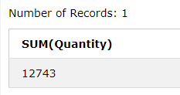

The COUNT, SUM and AVG Function
SELECT SUM(Quantity) FROM OrderDetails;
The statement reads “Determine the total number of products which have been sold by this business”
SELECT AVG(Price) AS Average_Price FROM Product;
The statement reads “Determine the average price of products which are sold by this businessess”

Slide 30
GROUP BY Statement
The GROUP BY statement groups rows that have the same values into summary rows, like "find the number of customers in each country".
The GROUP BY statement is often used with aggregate functions (COUNT, MAX, MIN, SUM, AVG) to group the result-set by one or more columns.
SELECT column_name(s) FROM table_name WHERE condition GROUP BY column_name(s) ORDER BY column_name(s);

Slide 31
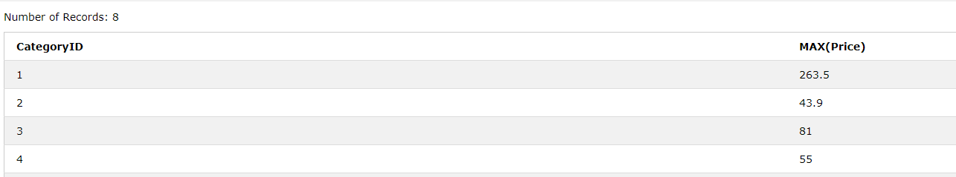
GROUP BY Statement
The GROUP BY statement groups rows that have the same values into summary rows, like "find the number of customers in each country".
The GROUP BY statement is often used with aggregate functions (COUNT, MAX, MIN, SUM, AVG) to group the result-set by one or more columns.
SELECT CategoryID, MAX(Price)
FROM Products GROUP BY CategoryID;
The statement reads “Find the maximum price of products per category”

Slide 32
The LIKE Statement
The LIKE operator is used in a WHERE clause to search for a specified pattern in a column.
There are two wildcards often used in conjunction with the LIKE operator:
% : The percent sign represents zero, one, or multiple characters
_ : The underscore represents a single character
SELECT column1, column2, ... FROM table_name WHERE columnN LIKE pattern;
SELECT * FROM Employees WHERE FirstName LIKE 'A%’;
The statement is tasked to find all employees who’s firstname starts with an A.

Slide 33
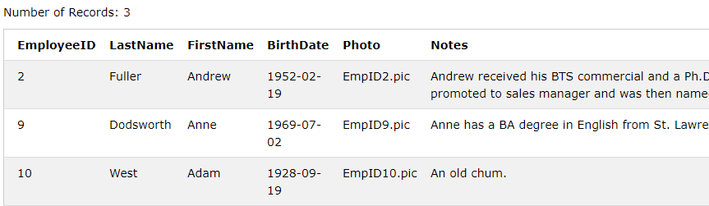
The LIKE Statement
SELECT * FROM Employees WHERE FirstName LIKE 'A%';

Slide 34
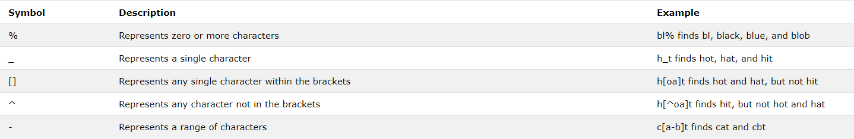
Wildcard Characters
A wildcard character is used to substitute one or more characters in a string.
Wildcard characters are used with the SQL LIKE operator. The LIKE operator is used in a WHERE clause to search for a specified pattern in a column.
Wildcard characters differ depending on the type of SQL used. Take note of this when implementing a SQL command.

Slide 35
SQL Null Values
A field with a NULL value is a field with no value.
If a field in a table is optional, it is possible to insert a new record or update a record without adding a value to this field. Then, the field will be saved with a NULL value.
As statisticians, when working with data we are expected to be able to deal with NULL values.
SELECT column_names FROM table_name WHERE column_name IS NULL;
SELECT column_names FROM table_name WHERE column_name IS NOT NULL;

Slide 36
Checkpoint Questions
Using the Order details table, determine the maximum quantity of each product that has been purchased (HINT: Each type of product sold is represented by product ID).
Using the notes provided for employees, find all employees that hold a BA degree.
How many null values are present in the FirstName of the Employees table?
Obtain the average product price without the use of the AVG function as seen in the table below.
SELECT AVG(Price) AS Average_Price FROM Product;
Answers:
SELECT MAX(Quantity) FROM OrderDetails
GROUP BY ProductID;
SELECT * FROM Employees
WHERE Notes LIKE ‘% BA %';
SELECT COUNT(FirstName) AS Null_Names FROM Employees
WHERE FirstName IS NULL;
SELECT SUM(Price)/COUNT(Price) AS Average_Price FROM Product;

Slide 37
Checkpoint 2 Questions
Using the Order details table, determine the maximum quantity of each product that has been purchased (HINT: Each type of product sold is represented by product ID).
Using the notes provided for employees, find all employees that hold a BA degree.
How many null values are present in the FirstName of the Employees table?
Obtain the average product price without the use of the AVG function as seen in the table below.
SELECT AVG(Price) AS Average_Price FROM Product;

Slide 38
Primary Keys vs Foreign Keys
The PRIMARY KEY uniquely identifies each record in a table.
A FOREIGN KEY is a key used to link two tables together.
A FOREIGN KEY is a field (or collection of fields) in one table that refers to the PRIMARY KEY in another table.

Slide 39
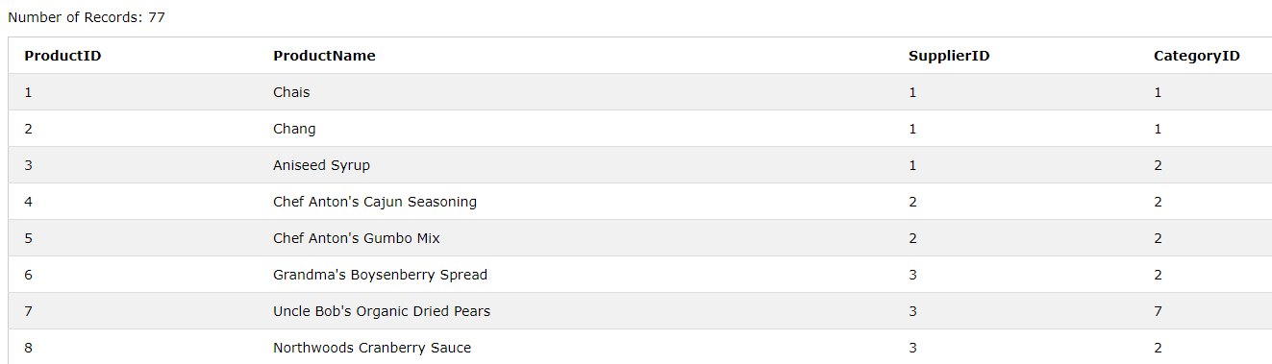
Identifying Primary and Foreign Keys in the Product Table
Foreign Key
Primary Key

Slide 40
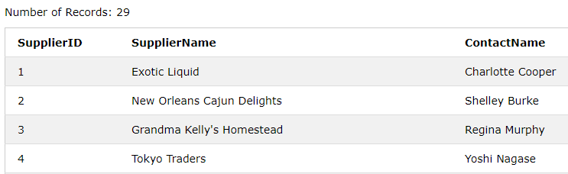
Identifying Primary and Foreign Keys in the Product Table
Primary Key

Slide 41
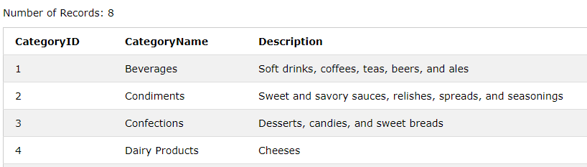
Identifying Primary and Foreign Keys in the Product Table
Primary Key

Slide 42
Primary Keys vs Foreign Keys
The use of PRIMARY and FOREIGN keys in tables forms part of good database design to ensure that tables are describing one element of the business process.
This does require us to use a variety of joining tools in order to aggregate tables together.
There are many different types of joining function we can use, the list below details the most frequently used joins.
Inner Join
Left Join
Right Join
Full Join
Self Join
Union

Slide 43
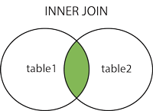
INNER JOINS(Intersection Join)
The INNER JOIN keyword selects records that have matching values in both tables.
The matching typically takes place on the primary key of one table and the foreign key of another.
SELECT column_name(s) FROM table1 INNER JOIN table2 ON table1.column_name = table2.column_name;
Question:
How does one obtain the order ID and Customer Name for each of the orders processed?

Slide 44
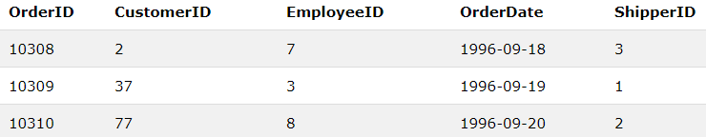
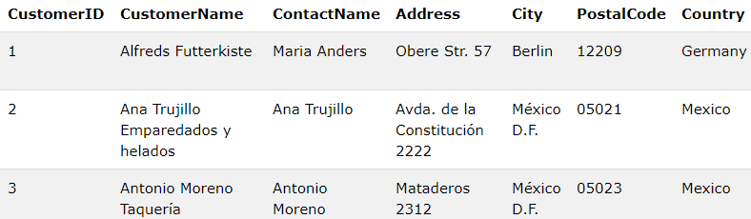
INNER JOINS(Intersection Join)

Slide 45
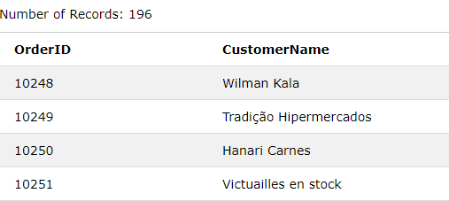
INNER JOINS (Intersection Join)
SELECT Orders.OrderID, Customers.CustomerName FROM Orders INNER JOIN Customers ON Orders.CustomerID = Customers.CustomerID;

Slide 46
INNER JOINS (Intersection Join)
The INNER JOIN keyword selects records that have matching values in both tables.
The matching typically takes place on the primary key of one table and the foreign key of another.
SELECT column_name(s) FROM table1 INNER JOIN table2 ON table1.column_name = table2.column_name;
Additional Question:
How does one obtain the order ID, Customer Name AND Shipper Name for each of the orders processed?

Slide 47
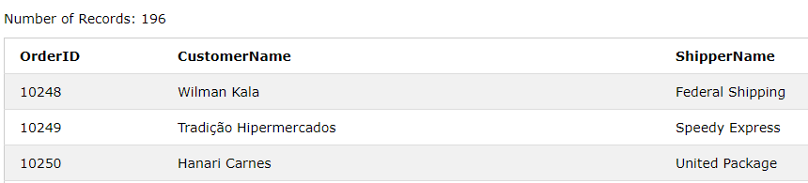
INNER JOINS (Intersection Join)
SELECT Orders.OrderID, Customers.CustomerName, Shippers.ShipperName FROM Orders INNER JOIN Customers ON Orders.CustomerID = Customers.CustomerID
INNER JOIN Customers ON Orders.ShipperID = Shippers.ShipperID;

Slide 48

Situations where INNER JOIN might not produce the desired results.
In order for an inner join to display each of the orders, each of the customers must exist in the customers table.
For example, if we insert a record into the orders table with a customer ID (92) that doesn’t exist in the customers table then the order will not be shown in the output of the inner join.
INSERT INTO Orders (CustomerID, EmployeeID, ShipperID)
VALUES (92, 2, 2);
SELECT Orders.OrderID, Customers.CustomerName
FROM Orders
INNER JOIN Customers ON Orders.CustomerID=Customers.CustomerID;
10444 not present in output!

Slide 49
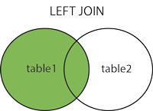
LEFT JOINS (All of Table 1 with an Intersection on Table 2)
The LEFT JOIN keyword returns all records from the left table (table1), and the matched records from the right table (table2). The result is NULL from the right side, if there is no match.
SELECT column_name(s) FROM table1 LEFT JOIN table2 ON table1.column_name = table2.column_name;

Slide 50
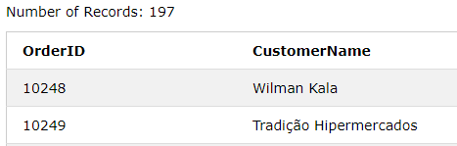

LEFT JOINS (All of Table 1 with an Intersection on Table 2)
The LEFT JOIN keyword returns all records from the left table (table1), and the matched records from the right table (table2). The result is NULL from the right side, if there is no match.
SELECT Orders.OrderID, Customers.CustomerName FROM Orders LEFT JOIN Customers ON Orders.CustomerID = Customers.CustomerID;

Slide 51
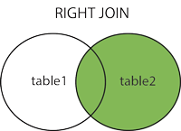
RIGHT JOIN
The RIGHT JOIN keyword returns all records from the right table (table2), and the matched records from the left table (table1). The result is NULL from the left side, when there is no match.
SELECT column_name(s) FROM table1 RIGHT JOIN table2 ON table1.column_name = table2.column_name;
https://www.w3schools.com/sql/trysql.asp?filename=trysql_select_join_right&ss=-1

Slide 52
RIGHT JOIN
The RIGHT JOIN keyword returns all records from the right table (table2), and the matched records from the left table (table1). The result is NULL from the left side, when there is no match.
SELECT column_name(s) FROM table1 RIGHT JOIN table2 ON table1.column_name = table2.column_name;
https://www.w3schools.com/sql/trysql.asp?filename=trysql_select_join_right&ss=-1
Question:
Determine a SQL Statement that will provide the order ID and employee name of every order fulfilled. Make sure that all employees (even those who have never fulfilled an order) are provided on the statement.
Notes:
Don’t Forget to restore database before trying right join.

Slide 53
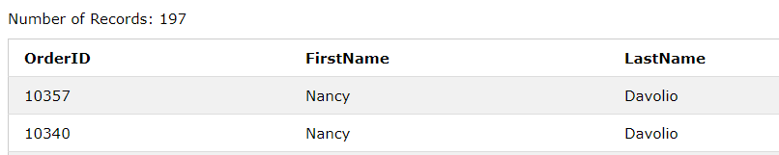
RIGHT JOIN
SELECT Orders.OrderID, Employees.FirstName, Employees.LastName
FROM Orders
RIGHT JOIN Employees
ON Orders.EmployeeID = Employees.EmployeeID

Slide 54
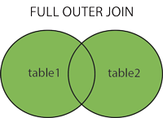
FULL JOIN
The FULL OUTER JOIN keyword returns all records when there is a match in left (table1) or right (table2) table records.
Note: FULL OUTER JOIN can potentially return very large result-sets!
Tip: FULL OUTER JOIN and FULL JOIN are the same.
SELECT column_name(s) FROM table1 FULL OUTER JOIN table2 ON table1.column_name = table2.column_name WHERE condition;

Slide 55
Some other Interesting Functions to Investigate
What we have discussed is just some of the functions available to SQL. Some other interesting functions/concepts include:
Case Statements
Null Functions
Aggregate functions with conditional criteria (HAVING function)
SQL Views
SQL Injection
Different SQL Dialects (Oracle, SQL Server, NoSQL)

Slide 56



Further Resources to Practice your SQL
W3Schools
HackerRank
Leetcode

Slide 57
Disclaimer
The content contained within this SQL Presentation makes use of the https://www.w3schools.com website for SQL Statement resources. Many SQL statements make use of statements contained on the site or are variants thereof.

Slide 58
www.mandela.ac.za

